Slide 1
Frictional Manipulation with Sliding
Francesco Iori, Anna Astolfi, Carlo Bosio, Jacopo Quaglierini
Contattaci: #week6 sul TMM Slack
Notes:
Jacopo - Goyal Ruina
Francesco - Intro & motivating examples
Anna - Lee + Howe & Cutkosky
Carlo - Sakurai
1 intro and motivation and examples -
2 Goyal Ruina paper
3 Lee and Sakurai
4 Howe & Cutkosky
(5) Set up the example⇒ Mark

Slide 2
Francesco - Intro & motivating examples

Slide 3
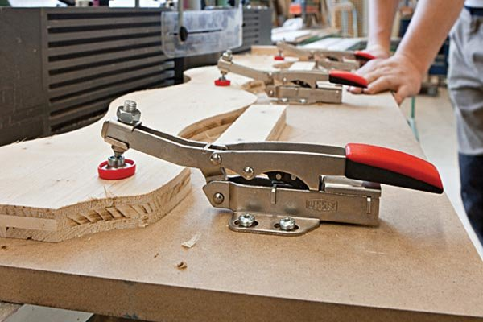

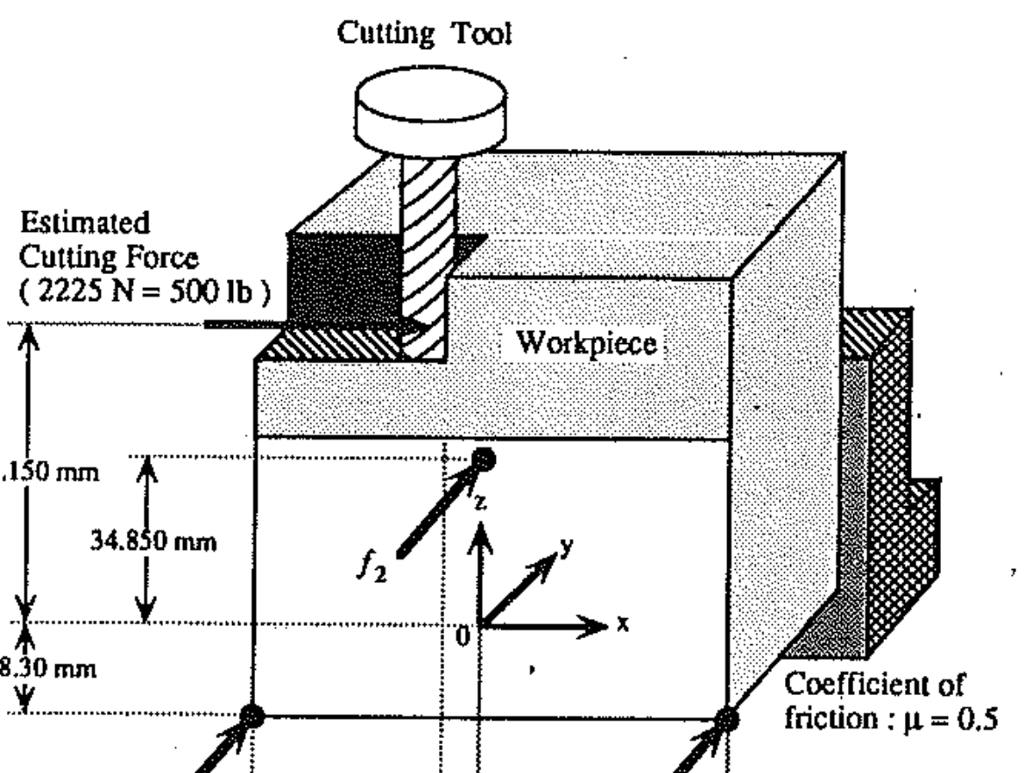
Applications: grasping, fixturing, in-hand manipulation
Huh, Tae Myung, et al. "Dynamically Reconfigurable Tactile Sensor for Robotic Manipulation." IEEE RA-Letters 5.2 (2020).

Slide 4

(video)
Hang, Kaiyu, Andrew S. Morgan, and Aaron M. Dollar. "Pre-grasp sliding manipulation of thin objects using soft, compliant, or underactuated hands." IEEE Robotics and Automation Letters 4.2 (2019): 662-669.

Slide 5
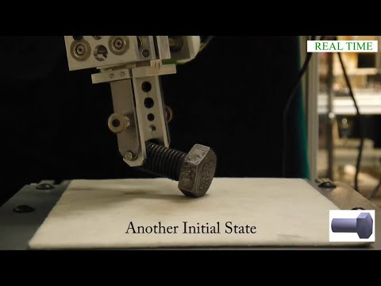
Hou, Yifan et al. “Reorienting Objects in 3D Space Using Pivoting.” ArXiv abs/1912.02752 (2019): n. pag.

Slide 6

Suggested paper for last 3 weeks of TMM
Chavan-Dafle, Nikhil, Rachel Holladay, and Alberto Rodriguez. "Planar in-hand manipulation via motion cones." The International Journal of Robotics Research 39.2-3 (2020): 163-182.

Slide 7
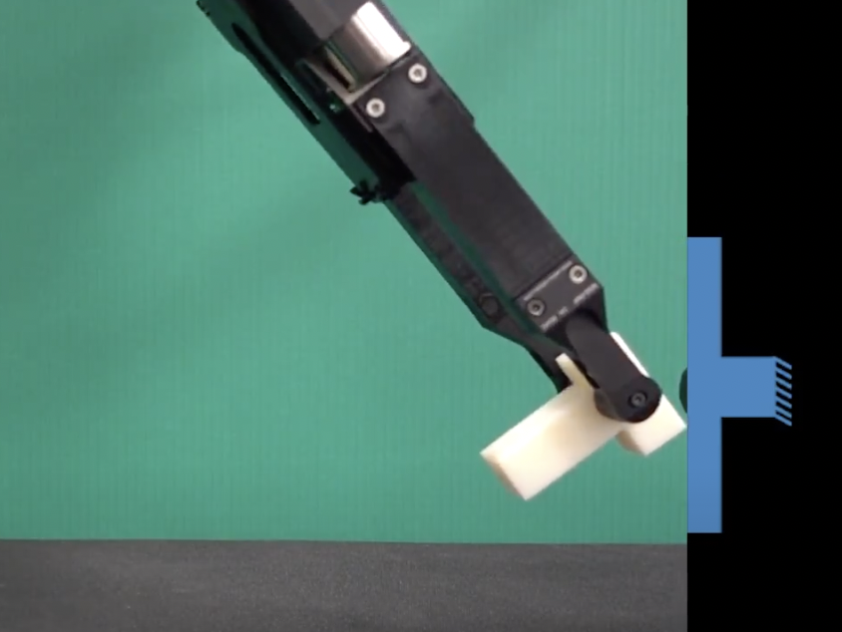
Suggested paper for last 3 weeks of TMM
Fext
(video)
Chavan-Dafle, Nikhil, Rachel Holladay, and Alberto Rodriguez. "Planar in-hand manipulation via motion cones." The International Journal of Robotics Research 39.2-3 (2020): 163-182.

Slide 8
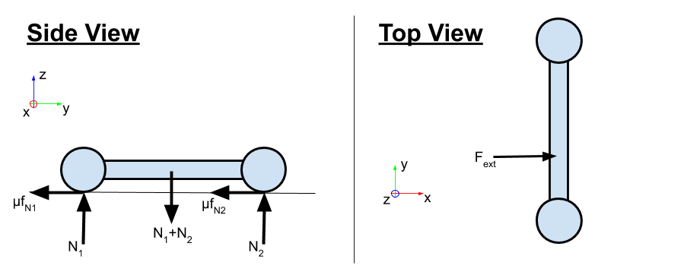
Motivating Question
Given a board with 2 “feet” (contact patches): How does it behave when you push on it? Can you predict when will it start to slide?
Try with your cell phone (which behaves almost the same way)
Can you predict the instantaneous motion direction (twist)?

Slide 9
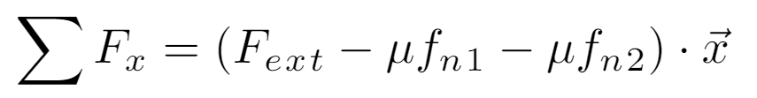
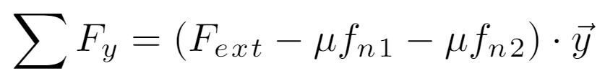
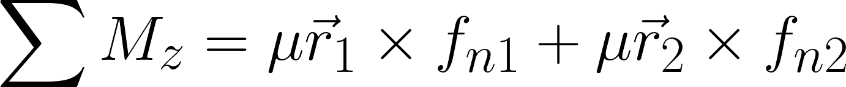
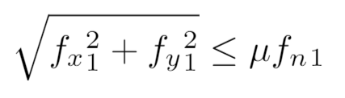
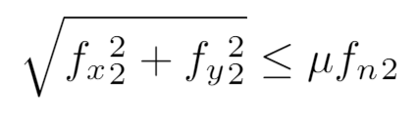
Our Board with 2 Feet, with equations
What is known, what is unknown?
4 unknowns
3 linear equations
2 non-linear constraints
Notes:
For some reason the 2020 students computed negative torque (f x r) instead of r x f… It makes no real difference.
Write the equations for the board with 2 feet and see if we can solve them.
NOTE: should I just introduce the problem or already point to the solution? I can say that, if the point of contact moves, the friction will be directed against their direction of motion, and that we will see a more generalized version of this now (with Jacopo)
Notice that if the COR location is known, we get linear equations. This also works if the COR is underneath any one of a small set of contact points -- it corresponds to “facets” on the LS, as seen in slide 6.

Slide 10
Equations on the board

Slide 11
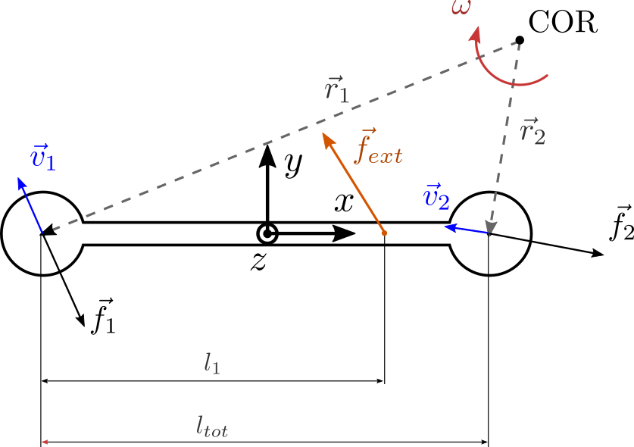
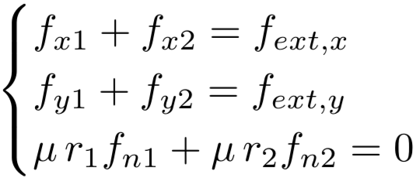
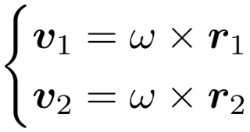
What about the friction forces?
Here we’re considering a quasi-static case.
We can define the instantaneous center of rotation (COR) and use it to describe how the body is moving
Top View
Notes:
For some reason the 2020 students computed negative torque (f x r) instead of r x f… It makes no real difference.
Write the equations for the board with 2 feet and see if we can solve them.
NOTE: should I just introduce the problem or already point to the solution? I can say that, if the point of contact moves, the friction will be directed against their direction of motion, and that we will see a more generalized version of this now (with Jacopo)
Notice that if the COR location is known, we get linear equations. This also works if the COR is underneath any one of a small set of contact points -- it corresponds to “facets” on the LS, as seen in slide 6.

Slide 12
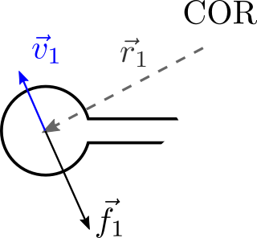
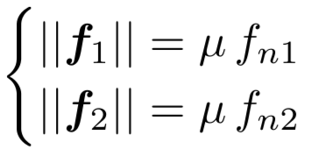
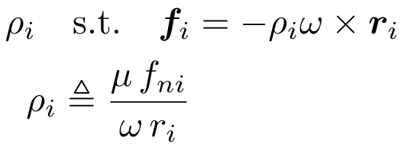
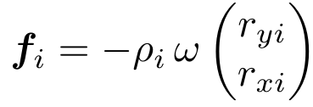
Friction forces direction
In each contact, the friction force is directed antiparallel to the direction of motion of the contact itself.
Top View
Notes:
For some reason the 2020 students computed negative torque (f x r) instead of r x f… It makes no real difference.
Write the equations for the board with 2 feet and see if we can solve them.
NOTE: should I just introduce the problem or already point to the solution? I can say that, if the point of contact moves, the friction will be directed against their direction of motion, and that we will see a more generalized version of this now (with Jacopo)
Notice that if the COR location is known, we get linear equations. This also works if the COR is underneath any one of a small set of contact points -- it corresponds to “facets” on the LS, as seen in slide 6.

Slide 13
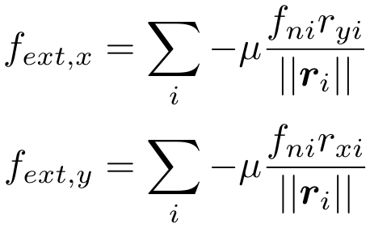
Result
Notes:
For some reason the 2020 students computed negative torque (f x r) instead of r x f… It makes no real difference.
Write the equations for the board with 2 feet and see if we can solve them.
NOTE: should I just introduce the problem or already point to the solution? I can say that, if the point of contact moves, the friction will be directed against their direction of motion, and that we will see a more generalized version of this now (with Jacopo)
Notice that if the COR location is known, we get linear equations. This also works if the COR is underneath any one of a small set of contact points -- it corresponds to “facets” on the LS, as seen in slide 6.

Slide 14
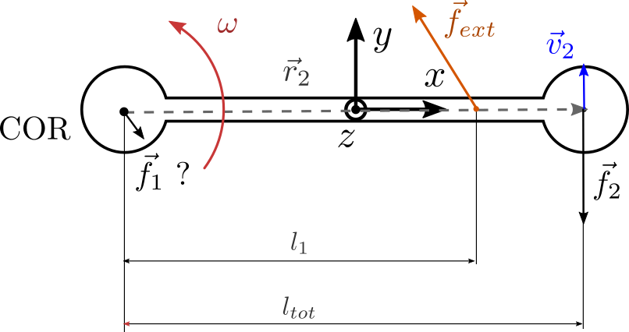
What if …
… one of the two contact points is the COR?
We will have to use the equilibrium equation for the body to determine the magnitude and the direction of f₁ (more about this in the rest of this class)
Notes:
For some reason the 2020 students computed negative torque (f x r) instead of r x f… It makes no real difference.
Write the equations for the board with 2 feet and see if we can solve them.
NOTE: should I just introduce the problem or already point to the solution? I can say that, if the point of contact moves, the friction will be directed against their direction of motion, and that we will see a more generalized version of this now (with Jacopo)
Notice that if the COR location is known, we get linear equations. This also works if the COR is underneath any one of a small set of contact points -- it corresponds to “facets” on the LS, as seen in slide 6.

Slide 15
Jacopo - Goyal Ruina

Slide 16
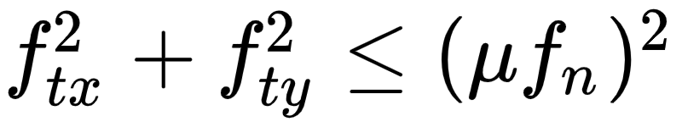
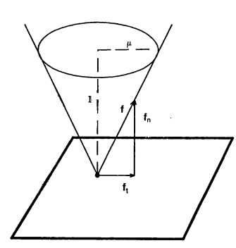
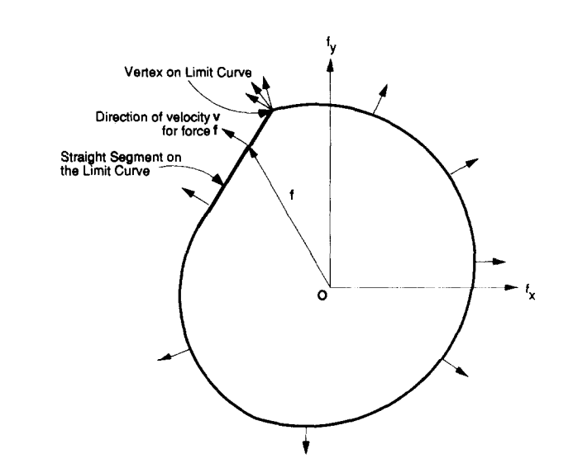
Friction Limit Surface Fundamentals
Goyal, Ruina & Papadopoulos: generalization (a “weak form”) of the Coulomb friction law
Given a known pressure distribution, instead of the classic friction cone, which describes a circle in the x-y plane given by we consider a convex closed shape as the limit curve for the corresponding friction force
Figs from: Mason, Mechanics and Planning of Manipulator Pushing Operations (1986), Goyal e al., Planar Sliding with Dry Friction, Part 1 (1990)
Notes:
Fig from Goyal, Ruina Papadopoulos paper, Planar Sliding with Dry Friction, Part 1 (1990)

Slide 17
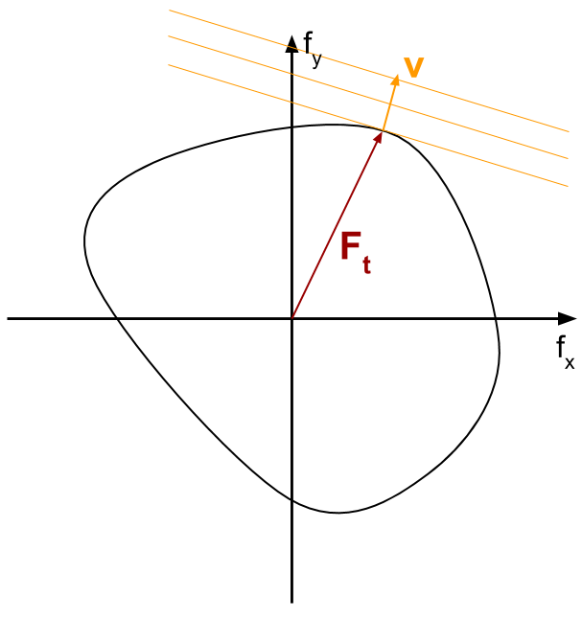
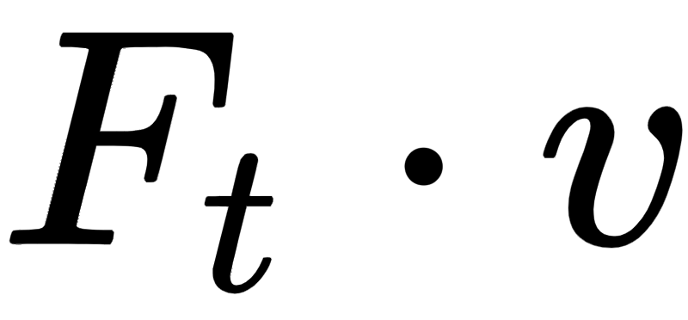
Friction Limit Surface Fundamentals
In most of the cases, we can assume that friction follows the Maximum-power Inequality:
Given a relative slip velocity v at the contact point, the corresponding friction force F_{t} = [f_{tx} f_{ty}] is the one that maximizes
This leads to 3 fundamental facts
No slip ⇒ any force vector F_{t} inside or on the limit curve is admissible;
Slip occurs ⇒ F_{t} is on the limit curve;
The relative slip velocity v is parallel to the normal vector of the curve where F_{t} intersects it
Notes:
Consider any direction, v. Take lines perpendicular to v and find where they intersect the limit surface. The maximum possible work (dissipated power) will be if F goes from the origin to the same point (maximum possible dot product of F and v). The same idea can be generalized to a convex friction surface in [fx,fy,mz] wrench space; now we take planes perpendicular to v and find when the intersect the surface.

Slide 18
Friction Limit Surface Fundamentals
In most of the cases, we can assume that friction follows the Maximum-power Inequality:
Given a relative slip velocity v at the contact point, the corresponding friction force F_{t} = [f_{tx} f_{ty}] is the one that maximizes
This leads to 3 fundamental facts
No slip ⇒ any force vector F_{t} inside or on the limit curve is admissible;
Slip occurs ⇒ F_{t} is on the limit curve;
The relative slip velocity v is parallel to the normal vector of the curve where F_{t} intersects it
If friction is isotropic, the LS
is a circle
Notes:
Consider any direction, v. Take lines perpendicular to v and find where they intersect the limit surface. The maximum possible work (dissipated power) will be if F goes from the origin to the same point (maximum possible dot product of F and v). The same idea can be generalized to a convex friction surface in [fx,fy,mz] wrench space; now we take planes perpendicular to v and find when the intersect the surface.

Slide 19
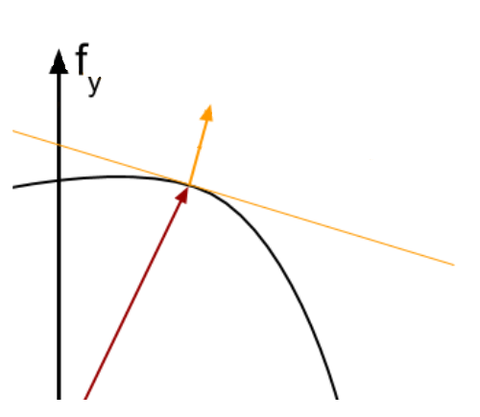

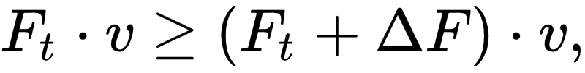
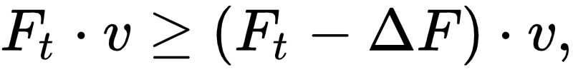
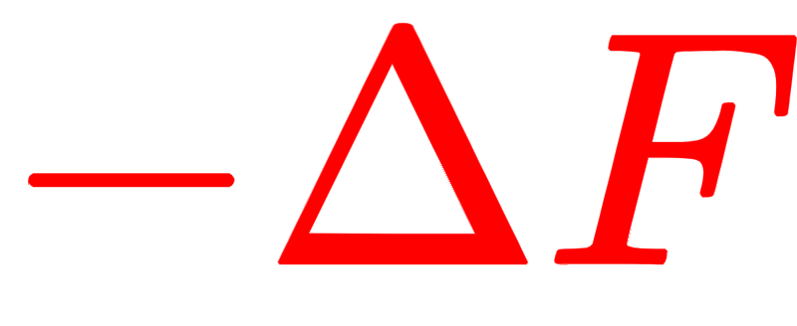

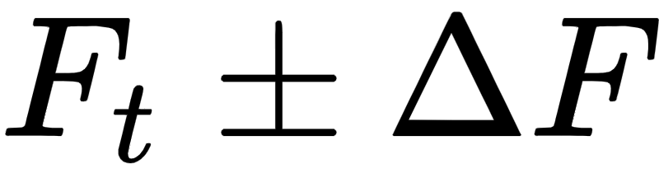
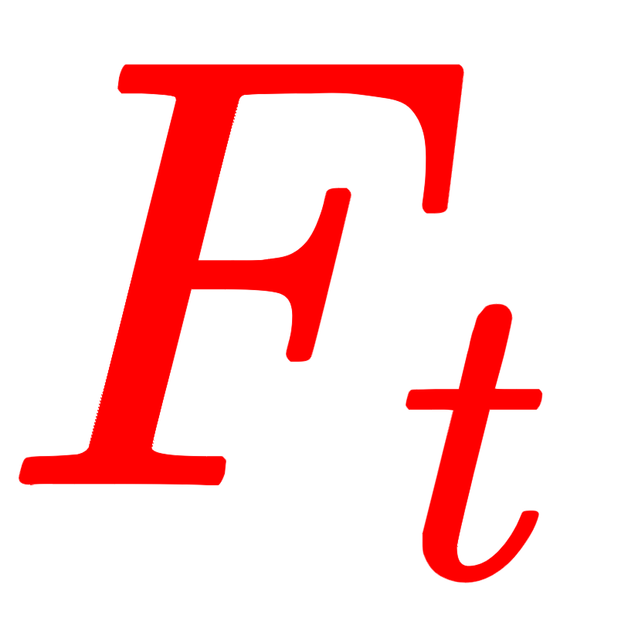
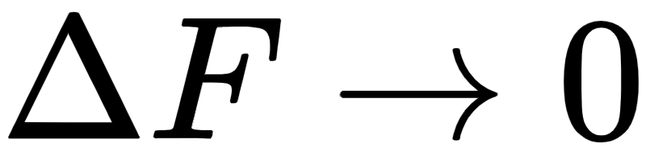

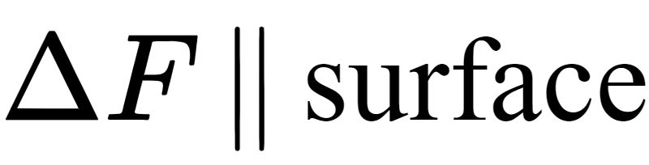

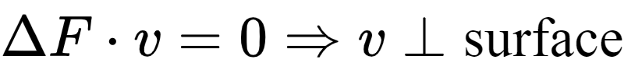
The Maximum-Power Inequality
Why is v normal to the curve?
Since F_{t} and v maximize frictional power, we have
where lies on either side of F_{t} on the limit curve.
In the limit of , the delta tends to become parallel to the surface at the crossing point, For both equations to hold true, we must have that
Notes:
Show a closed convex curve in (X,Y) space and [fx,fy] vectors and lines of orientation given by unit vector [vx,vy] and how where they contact the curve, the unit normal is tangent to the line. And also the product [ftx,fty]^t*[vx,vy] gives the maximum work (power) of all possible forces that intersect the curve.
In other words, given a direction [vx,vy], the corresponding slip force is the one on the curve that gives the maximum work.
So what? It means that if you construct a convex friction limit surface in wrench space F = [fx,fy,mz] for an object that slides on a physical surface you can use it to find both when an object will start to slide (when F intersects the limit surface) and in what direction it will move (given by the unit normal to the surface at the intersection).

Slide 20
The Maximum Work Inequality
Why does maximum-power inequality?
This assumption, borrowed from plastic deformation theory, is reasonable if we look at friction as a local form of plastic micro-deformations. Other laws are in principle possible, research is still open. In fact, “ [...] The reader is cautioned against trying to relate it to common notions of minimum potential energy or positive entropy production.”
Notes:
Show a closed convex curve in (X,Y) space and [fx,fy] vectors and lines of orientation given by unit vector [vx,vy] and how where they contact the curve, the unit normal is tangent to the line. And also the product [ftx,fty]^t*[vx,vy] gives the maximum work (power) of all possible forces that intersect the curve.
In other words, given a direction [vx,vy], the corresponding slip force is the one on the curve that gives the maximum work.
So what? It means that if you construct a convex friction limit surface in wrench space F = [fx,fy,mz] for an object that slides on a physical surface you can use it to find both when an object will start to slide (when F intersects the limit surface) and in what direction it will move (given by the unit normal to the surface at the intersection).

Slide 21
Load-Motion Inequality
How does the maximum-power inequality relate to the net frictional force and velocity of a sliding rigid body?
Let us assume that the rigid body is supported by N contact points. Equilibrium imposes that:
Let’s compute the external power for an arbitrary virtual twist Q = [V_{x}, V_{y} , ω]:

Slide 22
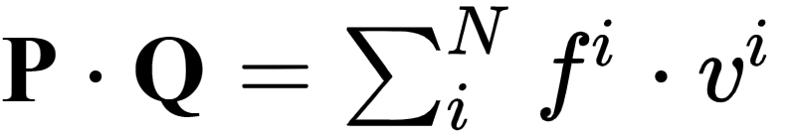
Load-Motion Inequality
For small rigid motions, [V_{x}, V_{y} ] can be expressed as V = v_{i} - ω r_{i} with respect to the single contact points, so that
Therefore we have
If we compute the same power for a generic P* on the limit surface (not curve!), we get
Which shows that also the body net frictional load and twist maximize frictional power

Slide 23
Anna - Howe, Cutkosky // Soo Hong, Cutkosky

Slide 24
Anna
A geometric way to build the Limit Surface (Lee/Howe/Cutkosky):
Think about a point sliding on the plane. Its friction is antiparallel to its velocity (if friction is isotropic)
If the point is part of a rigid body, the body is instantaneously rotating about some CoR (center of rotation) in the plane.
We can plot the corresponding wrench w = [fx, fy, mz] for that point about the origin.
Notes:
Lee and Cutkoskt ASME 1990

Slide 25
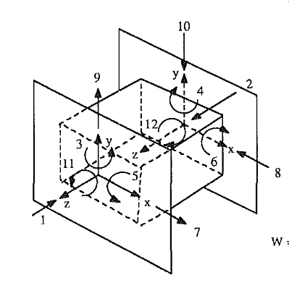
How can we build a Limit Surface ?
Notes:
If you think about holding an object during fixturing operations, you may be interest in knowing how it’s going to react to applied wrenches with respect to a static condition, when and how it is going to slip so that you can hold it safely.
This can be obtained without the knowledge of the pressure distribution by means of a slipping analysis, which uniquely relates relates twists to wrenches. This mapping results in the limit surface in the force space.

Slide 26
Geometric Method
Assumptions:
Consider a single point sliding on the plane, in isotropic friction condition.
Assume that the point belongs to a rigid body.
Assume you can measure the applied force.
What can we tell about the friction… ?
Notes:
Lee and Cutkoskt ASME 1990

Slide 27
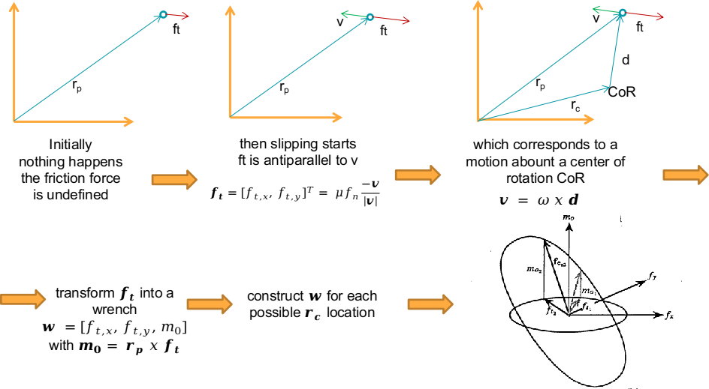
Notes:
Initially we cannot say anything because the rigid body does not move, we know that the friction is below some critic value but it is unknown…
Then it starts slipping and we observe a velocity. We know that the velocity is antiparallel with respect to ft. So we both know its direction and its magnitude. Notice that the magnitude of the velocity does not affect the friction force. Thi velocity may be thought as the velocity of the rigid body around a certain center of rotation, so that the rigid body is rotating with an angular velocity w and every point has a velocity w x d
Along with the in plane friction we can also compute a moment with respect to the origin of our reference frame as rp x ft, a torsional friciton, and we build up a wrench.
As ft depend on v wich in turns is defined with respect to a COR we can span several CoR position and collect the wrenches for each of them. We will get the ellipsoidal shape in figure. The moment is maximized when ft is orthogonal to rp, that is when CoR belong to rp. While ft is undefined when Cor exactly coincide with the point of contact. Here we have a singularity.
So for this shape all the results presented by Jacopo applies. We established a unique mapping between the physical space and the force space and we can predict how to apply forces in order to counteract slipping.

Slide 28
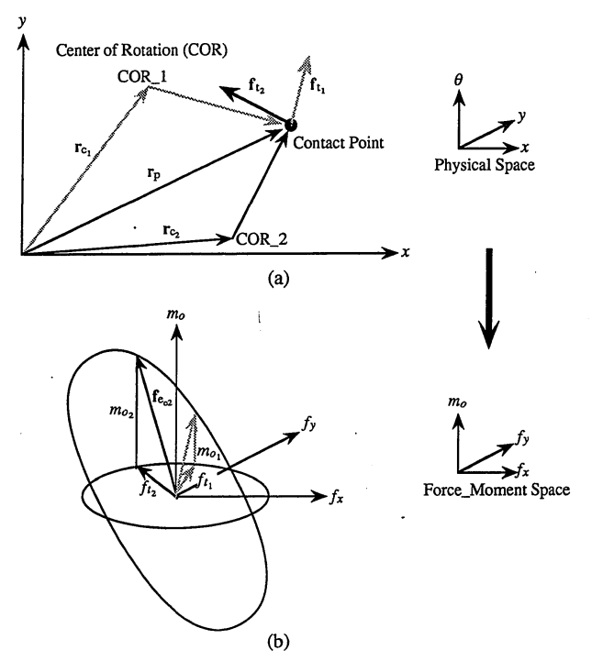
Limit Surface for 1 point on a rigid body
A point in a body sliding on the plane is instantaneously rotating about some CoR.
Its friction force is [f_{tx} f_{ty}] and is antiparallel to its sliding velocity [v_{x} v_{y}].
The corresponding wrench is [f,m_{z}] where f = [f_{tx} f_{ty}] , m_{z} = rxf, and r is from the origin to the point.
Fig from S-H Lee thesis (1990) showing 2 COR locations and their mapping to the Limit Surface (LS), which is an ellipse in SE(2). If we try all possible COR locations, we plot the ellipse. (Note that mz does not depend on COR location!)
Notes:
Fig from S-H Lee thesis (1990) showing 2 COR locations and their mapping to the Limit Surface (LS), which is an ellipse in SE(2). If we try all possible COR locations, we plot the ellipse. (Note that mz does not depend on COR location, only on where the point is with respect to the origin.)

Slide 29
What happens when we increase the number of contact points?
How many contact points should be considered?

Slide 30
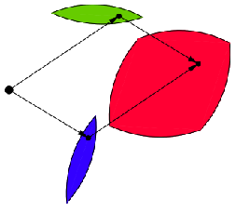
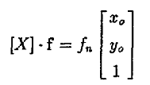
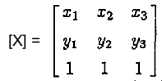
Important Results towards N-points contact
Goyal (1989) shows that the limit surface for a set of contact points can be obtained as the Minkowsky sum of the ellipses of each contact.
Mason (1986) showed that the tripod support is particularly useful as any pressure distribution satisfying the equilibrium equations for stability with respect to the plane can be approximated with a tripod with the same centroid.

Slide 31
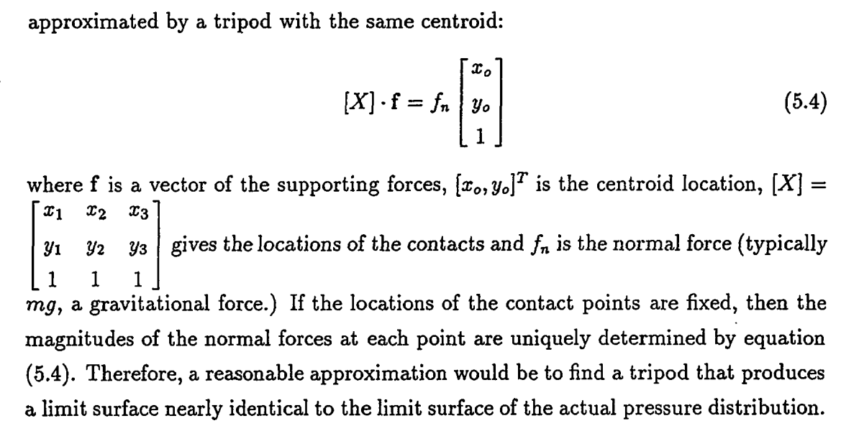
An arbitrary pressure distribution can often be...
Lee (1990), Mason (1986)
Notes:
Mason noted the above, which is convenient for approximating general pressure distributions.
And as noted in Howe & Cutkosky the actual limit surface is not very sensitive to the details of the pressure distribution.
Therefore, approximating a general pressure distribution with three points may often be good enough for practical purposes.

Slide 32
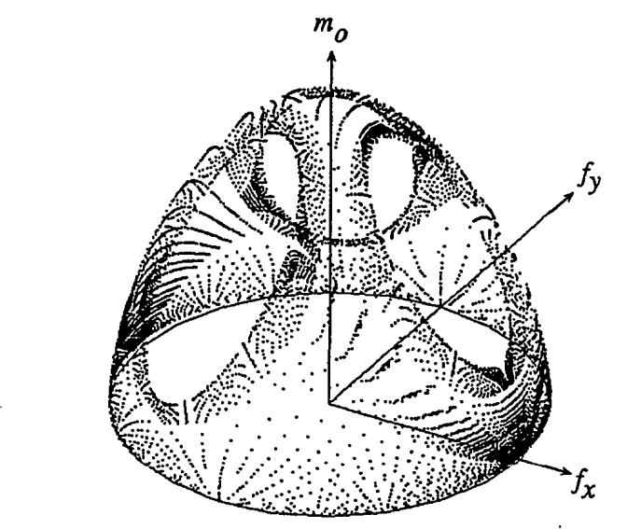
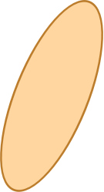
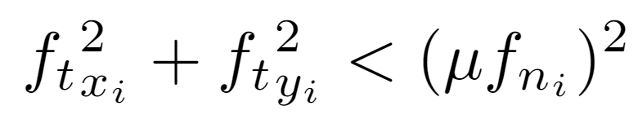
Limit Surface for multiple points
We can extend the point analysis to a collection of points for a body sliding in the plane in SE(2).
We can sum the forces and moments from each point and plot the resulting wrenches in [fx,fy,mz] space.
Or we can create the LS as the Minkowski sum of the LS from each point.
The LS of any pressure distribution is the Minkowski sum of the LS of its constituent components.
On the (fx,fy) plane we have a circle
Notes:
Fig from S-H Lee thesis (1990) showing LS for 3 points. The facets correspond to when COR is directly beneath one of the points, so for that point there are multiple solutions: ftx_i^2 + fty_i^2 < (mu fn_i)^2
A thing about friction limit surfaces is that they are often not intuitive because the force is independent of the magnitude of velocity.
LS for multiple points or contact patches = Minkowski sum of the LS for each of the points or patches.

Slide 33
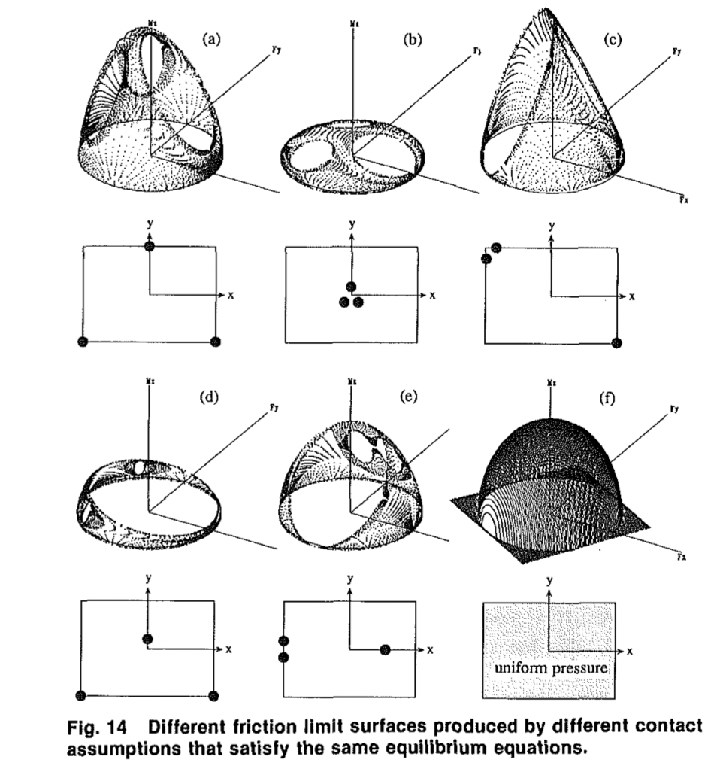

Slide 34
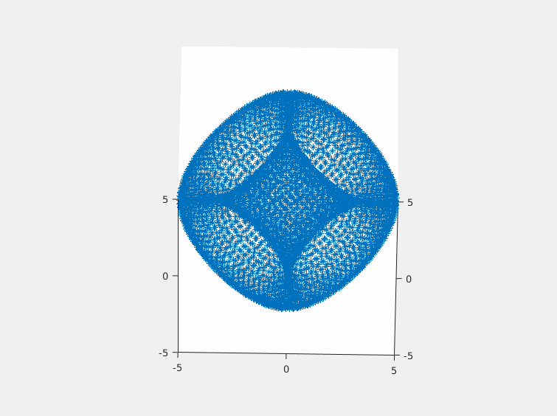
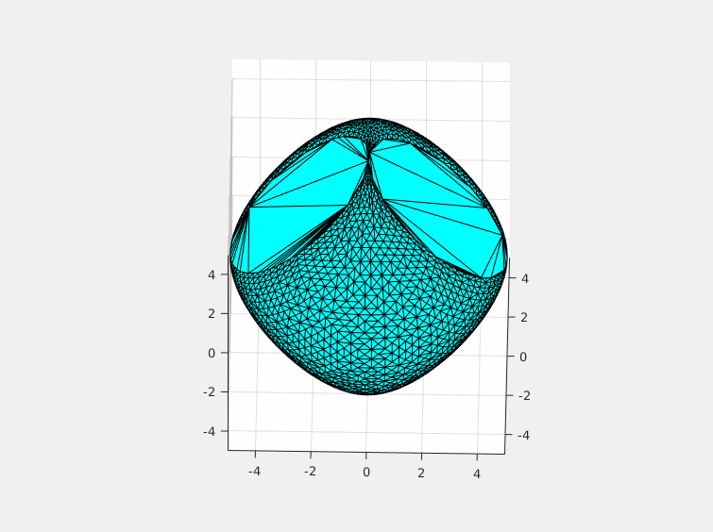
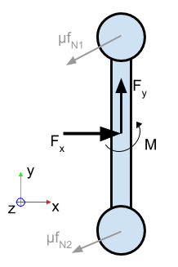
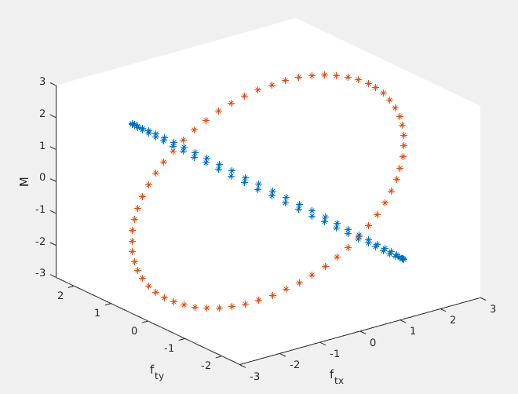
Back to our board with 2 feet, we have a limit surface with 2 large facets
The ellipsoidal limit surface can be considered both above and below the mz=0 plane. The part below is for rotations in the opposite sense, and is a mirror image of the part above
Notes:
Each contact patch results in a friction LS that is a tilted ellipse in wrench space [fx, fy, mz]. The combined LS can be obtained by taking the Minkowski sum of these 2 ellipses, or plotted directly in wrench space. The result is the convex shape at right. Note that it can go both and above the mz=0 plane, depending on whether rotations are clockwise or anticlockwise.

Slide 35
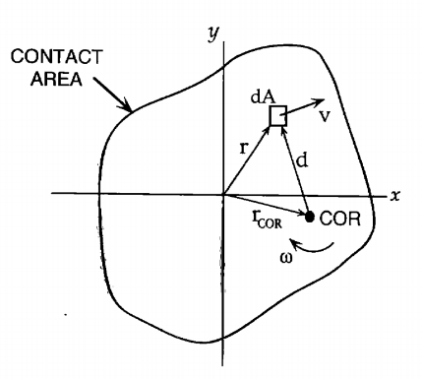
Howe/Cutkosky: From point contact to Pressure Distributions
Howe and Cutkosky (IJRR 1996) consider arbitrary pressure distributions and calculate the net force and moment for each sliding element.
An ellipsoidal approximation (with facets removed if there are just a few contacts) is a fast and reasonably accurate way to get the force and sliding direction.

Slide 36

For many pressure distributions, an approximating ellipsoid is reasonably accurate, especially if we put the origin at the center of pressure and if the pressure distribution is not very asymmetric.
The normal to the ellipsoid is easy to compute and gives the sliding direction.
m/m_{max}
Example for a long skinny rectangle (approaching the 2 point case - which one could also use).
f_{t}/f_{tmax}
Notes:
Two assumptions: pressure distribution is more or less symmetric and we put origin at center of pressure.
Then normal of the epllisoid can be calcuated, and it gives the sliding direction per max work inequality

Slide 37

Example from S-H Lee on accuracy of ellipsoid
If the pressure distribution is not relatively symmetric about origin, you can create a tilted ellipsoid that has its long axis terminate at m_max, which occurs if COR is at origin.
Then remove facets if COR could be at one of a few support points.

Slide 38
Carlo - Sakurai (MIT 1990)

Slide 39
Grasp and fixture planning with friction
Sakurai (MIT) and Lee (Stanford) ~1990 considered the problem of a workpiece held by clamps with friction:
How many clamps needed?
Where to put them?
Maximum external force = ?

Slide 40
Sakurai and Lee Assumptions
Friction forces are dominated by the forces under each clamp.
Clamp contact areas are small enough to approximate by frictional point contacts.
We know where an external wrench [fex, fey, mez]’ is being applied (e.g. by a cutting tool) but we do not know the maximum magnitude that can be resisted without slipping.

Slide 41

Imagine our board with 2 feet is a part being clamped by two clamps.
4 unknowns
3 linear equations, 2 non-linear constraints (what are they?)
Based on Maximum Work Inequality, we want to maximize power
Where F_{t} = frictional sliding force
Notes:
For some reason the 2020 students computed negative torque (f x r) instead of r x f… It makes no real difference.
Write the equations for the board with 2 feet and see if we can solve them.
Notice that if the COR location is known, we get linear equations. This also works if the COR is underneath any one of a small set of contact points -- it corresponds to “facets” on the LS, as seen in slide 6.

Slide 42

If the object is rotating about one of the contact points (corresponding to a facet on the limit surface)
4 unknowns
3 linear equations
1 non-linear equality
1 non-linear inequality constraint
Notes:
Write the equations for the board with 2 feet and see if we can solve them.
Notice that if the COR location is known, we get linear equations. This also works if the COR is underneath any one of a small set of contact points -- it corresponds to “facets” on the LS.

Slide 43








Back again to our same example, now with COR
-
Knowns:
Unknowns:
actually, f2 is this way...
Notes:
Write the equations for the board with 2 feet and see if we can solve them.
Notice that if the COR location is known, we get linear equations. This also works if the COR is underneath any one of a small set of contact points -- it corresponds to “facets” on the LS.

Slide 44
Notes:
Solvable in theory but difficult in practice. We look for a better way.
What are the known and unknown quantities in these two equations? We assume we know where the points are, but we don’t know where the COR is. So we don’t know the quantities like (xi - x) and (yi - y) because we don’t know x and y. We also know the ratio fx/fy (direction of pushing force) but not the magnitude.
But it’s very messy. Conversely, if we did know the COR, then it’s easy to compute fx and fy. Then all the (xi-x) terms are known and for those points that are sliding we know mu*fi.

Slide 45
Review Sakurai (1990) example in more detail in preparation for the assignment
Notes:
We will need to spend awhile on this one. There is a lot to it. Maybe breakout to white board to talk people through the details.

Slide 46

Sakurai setup: consider an object sliding in the plane

Slide 47

The object has n points of contact and rotates about some CoR

Slide 48

Sakurai worked example (eq 4.2.9)

Slide 49

Possibly it rotates about one of the contacts

Slide 50

Possibly it rotates about one of the contacts

Slide 51

Sakurai example Fig. 4.2.7 and results
Sakurai does not solve this using the special case method in the last slide. Instead he applies the Maximum Work method, and obtains the same result

Slide 52


More generally:
-

Slide 53
Exercise Questions
Q1: Using the file SakuraiFriction.py, reproduce the example problem in pages 90-100 of H. Sakurai’s MIT PhD thesis. (You will need to fill in some missing blanks in the script toward the end)
Answer questions on the accuracy of the approach.

Slide 54
Exercise Questions
Q 2: Use the script LS-ellipsoid.py to solve the same Sakurai example using the Howe/Cutkosky/Lee ellipsoidal approximation to the friction limit surface. This script is essentially complete, so it’s just a matter of understanding it as you step through it.
Answer questions on the accuracy of the approach.

Slide 55

Q3. FlyCro Tugs
Video ( EPFL/ Stanford )

Slide 56

Exercise Questions
Q3: A FlyCroTug* has attached a gripper to one leg of a divan and is attempting to drag it (see illustration and diagram in assignment with dimensions & data).
Use the approximating LS Ellipsoid (adapt from Q2) to solve for the instantaneous motion and required tugging force.
*Estrada, M. A., Mintchev, S., Christensen, D. L., Cutkosky, M. R., & Floreano, D. (2018). Forceful manipulation with micro air vehicles. Science Robotics, 3(23), eaau6903.

